Slide 1

The Linux Filesystem
Miroslav Biňas
(c) 2010 - 2013
Notes:
158 min (4)
doplnit:
chyba sposob zapisu prav v absolutnom rezime (je az neskor)
prezriet slajdy o SGID-e - v nazvoch je 2x - aj pri suboroch aj pri priecinkoch, ale venuje sa mu iba slajd s priecinkami
obrazok o inodoch
treba prehodit slajd o file/dir pristupovych pravach az za temu o ich modifikacii/pracu s nimi
co znamena grace doplnit
ku du by bolo dobre pridat slajd o tom, ako je to s diskom, sektormi a ukladanim udajov

Slide 2


Filesystem Support
filesystem – method of storing and organizing computer files and their data
used on data storage devices to maintain the physical location of the files
Linux supports many filesystems
able to coexist with other OS

Slide 3
UNIX/Linux Filesystem Features
everything is file!
tree hierarchy
root / (only one)
cAsE SenSItiVitY
long file names
supports links
virtual filesystem (VFS)
provides filesystem abstraction
kernel translates abstract-to-actual
very flexible (coexistence with other filesystems and OS)

Slide 4
Different File Types
regular files
directories
special files
symbolic links
named pipe files - FIFO
block files - hw devices (in /dev/)
character device files - serial stream of I/O (terminals - /dev/tty*)
socket files - used to pass information between apps for communication purposes
Notes:
http://www.linuxnix.com/2010/02/file-types-in-linux.html

Slide 5
Filesystem Hierarchy Standard I.
defines the main directories and their contents in Linux operating systems
maintained by the Free Standards Group, now the Linux Foundation
members such as HP, Red Hat, IBM and Dell

Slide 6
Filesystem Hierarchy Standard II.
/bin - Essential command binaries, that need to be available in single user mode
/boot - Static files of the boot loader
/dev - Device files
/etc - Host-specific system configuration
/lib - Essential shared libraries and kernel modules

Slide 7
Filesystem Hierarchy Standard III.
/media - Mount point for removeable media
/mnt - Mount point for mounting a filesystem temporarily
/opt - Add-on application software packages
/sbin - Essential system binaries
/srv - Data for services provided by this system

Slide 8
Filesystem Hierarchy Standard IV.
/tmp - Temporary files
/usr - Secondary hierarchy
/var - Variable data
/proc - Virtual filesystem documenting kernel and process status as text files

Slide 9
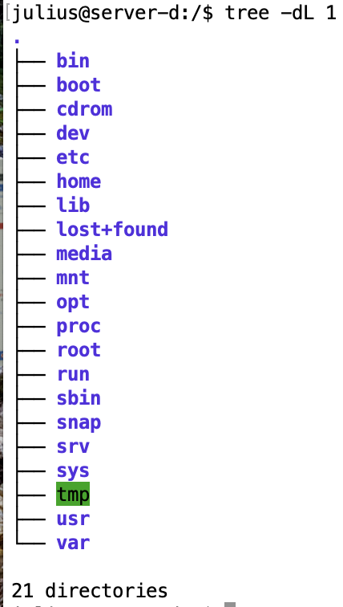
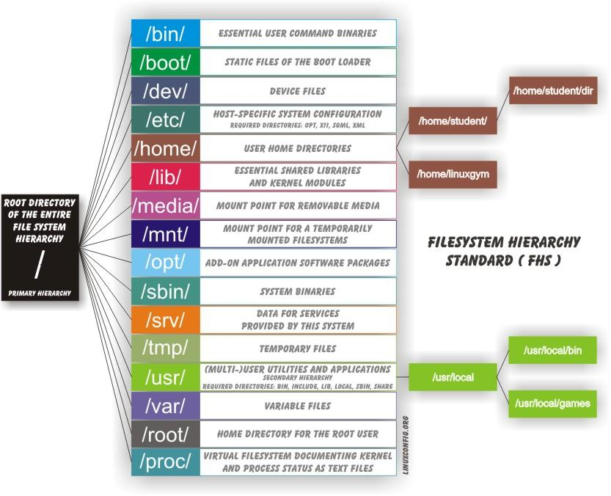
Filesystem Overview
Tree nefunguje v WSL2
Notes:
http://www.linoob.com/2012/03/linoobs-guide-to-ubuntu-filesystem-structure/

Slide 10
Navigating the Filesystem I.
paths
absolute
relative
(current/working)
special directories
/ - root directory
~ - home directory
.. - level up directory
. - current directory

Slide 11
Navigating the Filesystem II.
pwd - locates the current working directory
cd – change directory command
syntax: $ cd [DIR]
if no directory is specified, changes directory to home directory
possible to use special directory names for relative path construction

Slide 12
Displaying Directory Contents I.
ls – lists the content of directory
syntax: ls [OPS] [DIR]
if no directory is specified, lists the content of current directory
options:
-a – list all files (also hidden ones starting with .)
-l – list long, detailed info
-h – human readable format (K,M)
-R – list subdir recursively

Slide 13
Displaying Directory Contents II.
$ ls -la /home/mirek total 158 drwxrwxrwx 2 mirek users 4096 May 12 13:55 . drwxr-xr-x 3 root root 4096 May 10 01:49 .. -rw-r--r-- 1 mirek users 24 May 10 01:50 1.txt -rw-r--r-- 1 mirek users 230 May 10 01:50 2.txt
-rw-r--r-- 1 mirek users 124 May 10 01:50 text
drw-r--r-- 1 mirek users 4096 May 10 01:50 .kde -rw-rw-r-- 1 mirek users 149872 May 11 22:49 test ^ ^ ^ ^ ^ ^ ^ col 1 col 2 col 3 col 4 col 5 col 6 col 7

Slide 14
Displaying Directory Contents III.
total – total amount of disk space used by the files (block size stat –f .)
col 1 – permissions and file type (first character):
- - normal file
d – directory
l – link
b – block device
c – character device

Slide 15
Displaying Directory Contents IV.
col 2 – number of links to item
col 3 – file or directory owner
col 4 – file or directory group
col 5 – size of each file in bytes
directory size – reflects the file with info about the directory
col 6 – date and time of last modification
col 7 – file and directory names

Slide 16
Determining Disk Usage I.
du – finds out, how much space is being consumed by particular dir (and its subdirs)
syntax: du [OPS] [DIR]
if no dir is specified, current dir is used
at the end, du calculates total disk space used in specific dir (with -s option only this number is showed)
option -h provides human readable format

Slide 17
Determining Disk Usage II.
df – report file system disk space usage
syntax: df [OPS] [FILE]
option -h provides human readable format
-i list inode info instead of block usage
-T print file system type
df –T (napr. /dev/sdc ext4)
Notes:
man df

Slide 18
Disk Usage with Quotas I.
Quota nefunguje vo WSL2
quota provides restrictions for the amount of disk space used on partition by user or group
two types of quota
usage/block quota - limits amount of disk space that can be used
file/inode quota - limits the number of files and directories, that can be created
check your quota with quota command

Slide 19
Disk Usage with Quotas II.
$ quota
Disk quotas for user mirek (uid 1036):
Filesystem blocks quota limit grace files quota limit grace /dev/md3 4436900 7680000 10240000 49514 0 0
filesystem - limited filesystem
blocks - amount of used blocks
quota - soft quota (users are informed)
limit - hard quota
files - nr. of created files
Inštalácia quota na linux mint
https://linuxhint.com/disk_quota_ubuntu/
Notes:
grace period - http://nixcraft.com/centos-rhel-fedora/14005-what-grace-time-period-disk-quota.html
http://www.yolinux.com/TUTORIALS/LinuxTutorialQuotas.html
????

Slide 20
File Ownership I.
Only the root user can change the owner of a file.
You can change the group of a file only if you are a root user or if you own the file.
If you own the file but are not a root user, you can change the group only to a group of which you are a member.
each file is owned by specific UID and GID
chown – change file owner and group
user must be member of changing group
chown [OPS] [OWN][:GRP] FILE
options
-R – recursive change
example:
$ sudo chown root:root xx.txt
Notes:
ako oddelovac moze byt pouzity aj znak .

Slide 21
File Ownership II.
chgrp – change group ownership
user must be member of changing group
options
-R – recursive change
example
$ chgrp -R users doc/

Slide 22
Default Group Ownership
each user has default group
default group is used as group ownership for every newly created file or directory
newgrp - log in to a new group (gpasswd)
newly created files will be owned by this group
user must be member of such group or must be root
exit to switch back

Slide 23
File and Dir Permissions I.
permissions are attributes of file, which define access to file or directory by owner, group or others
permissions can be set for reading, writing and executing
to see file or directory permissions, type
$ ls -ld ch3 test
-rw-rw-r-- 1 chris sales 4983 Jan 18 22:13 ch3 drwxr-xr-x 2 chris sales 1024 Jan 24 13:47 test

Slide 24
File and Dir Permissions II.
permissions for files and directories have different meaning
Permission | File | Directory
Read | view file content | show list of files and dirs in directory
Write | change file content, rename it, delete it | add and delete files or subdirs
Execute | run file as program | cd to dir, search or execute programs, show file info

Slide 25
File and Dir Permissions III.
two notation systems for summarizing permissions in UNIX/Linux systems:
symbolic or textual representation, ex. rwx--x--x
absolute or octal representation,ex. 0711
R-xr-x--- 550

Slide 26
File and Dir Permissions IV. Symbolic Mode
in symbolic mode permissions are written as a series of 10 chars, eg. -rwxrwxrwx
first char - file type (see Displaying Directory Contents)
next three - owner perms
next three - group perms
next three - others perms

Slide 27
File and Dir Permissions V. Symbolic Mode
in each group of three:
r – permission to read
w – permission to write
x – permission to execute
- - permission is not set

Slide 28
File and Dir Permissions VI. Absolute Mode
used more often than symbolic mode
in each access group are 3 bits
each bit represents one specific permission (rwx)
3 bits together represents group permission
final value of perms is counted as sum of values of needed perms
user
group
others
r
w
x
r
w
x
r
w
x
400
200
100
40
20
10
4
2
1

Slide 29
File and Dir Permissions VII. Absolute Mode
permissions | absolute mode
-rw-r--r-- | 644
-rw-r----- | 640
-rwxrwxrwx | 777
if you want to add to user r-x permissions in absolute mode, you can count it as follows: 400+0+100=500

Slide 30
File Creation Permissions I.
the default permissions after file creation - rw-r--r--
the default permissions after directory creation - rwxr-xr-x
default permissions can be changed with umask command
with no argument shows umask value:
$ umask
0022

Slide 31
File Creation Permissions II.
umask - set file mode creation mask; masks the permissions value of
666 for file (exec permission is off for regular files)
777 for directory
with default value 0022 is result for
file: 666–022=644 (rw-r--r--)
dir: 777–022=755 (rwxr-xr-x)

Slide 32
Changing File Permissions I.
if user owns a file, he can change it's permissions with chmod
syntax:
$ chmod [OPT] [PERM] [FILES]
general options
-R - recursive change
-v - output for every single processed file
-c - like -v, but outputs only changed files

Slide 33
Changing File Permissions II.
two methods of changing permissions:
by the total value of permission (absolute mode)
by the special signs (symbolic mode)

Slide 34
Changing File Permissions III. By Total Value
permissions are written in octal code
each permission has a weight:
r - 4
w - 2
x - 1
- - 0
final permission is evaluated as sum
examples:
rwx = 4+2+1 = 7
r-x = 4+1 =5
--x = 1 = 1

Slide 35
Changing File Permissions IV. By Total Value - Examples
$ ls -lh picture.jpg
-rw-r--r-- .. picture.jpg
$ chmod 755 picture.jpg
$ ls -lh picture.jpg
-rwxr-xr-x .. picture.jpg

Slide 36
Changing File Permissions V. By Special Signs
used for symbolic mode
permissions are composed from three groups of special signs:[CATEGORY][ACTION][PERM] where
edited category settings (agou)
action settings (+-=)
permission settings (-gorstuwx)

Slide 37
Changing File Permissions VI. By Special Signs
action settings
+ - add permission
- - remove permission
= - set exact permission
edited category settings
a - all
g – group
o – others
u – user (owner)
permission settings
- - no permission
r - read
w - write
x - execute
s – SUID and SGID bit
t – sticky bit
u – same as owner
o – same as others
g – same as group
chmod a+rwx subor.txt

Slide 38
Changing File Permissions VIII. By Special Signs
$ ls -lh picture.jpg
-rwxr-xr-x .. picture.jpg
$ chmod u+rw,g-x,o-x picture.jpg
$ ls -lh picture.jpg
-rwxr--r-- .. picture.jpg

Slide 39
SUID Bit on Files I.
SUID – Set User ID
file is run with the permissions of file owner
useful for special tasks, which requires higher privileges, e.g. changing of user's password
possible security risks
example of perms with SUID:
$ ls -lh /usr/bin/passwd
-rwsr-xr-x .. /usr/bin/passwd

Slide 40
SUID Bit on Files II.
SUID can be set with chmod
set SUID in absolute mode
setting of high-order octet to 4$ chmod 4711 file.txt
set SUID in symbolic mode
special permission setting character 's‚
$ chmod u+s file.txt

Slide 41
SGID Bit I.
SGID – Set Group ID
file is run with the permissions of file group
if set for directory, newly created files and directories inherit it's group ID instead of creator's primary group ID

Slide 42
SGID Bit II.
SGID can be set with chmod
set SGID in absolute mode
setting of high-order octet to 2
$ chmod 2711 file.txt
set SGID in symbolic mode
special permission setting character 's‚
$ chmod ug+s file.txt

Slide 43

Sticky Bit on Directories I.
Sticky Bit
can be set to directories only
if set, only owner or superuser can rename or delete files inside “sticky” directory
example: /tmp

Slide 44
Sticky Bit on Directories II.
set Sticky Bit in absolute mode
setting of high-order octet to 1
$ chmod 1711 dir
set Sticky Bit in symbolic mode
special perm setting character 't‚
$ chmod +t dir

Slide 45
User Private Group Scheme
each user has a "user private group" (UPG)
special group for each user
has same name as user
no other user is member of "user's private group"

Slide 46
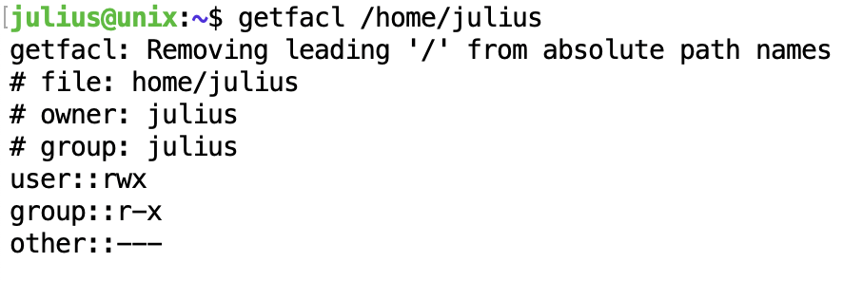
UNIX ACL
ACLs allow us to apply a more specific set of permissions to a file or directory without (necessarily) changing the base ownership and permissions.
sudo apt-get install acl
dpkg -s acl zistí, či je balík ACL už nainštalovaný

Slide 47
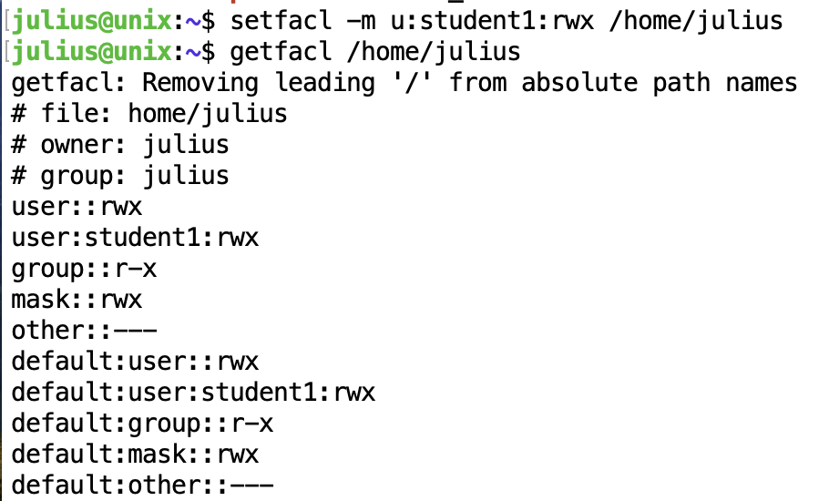
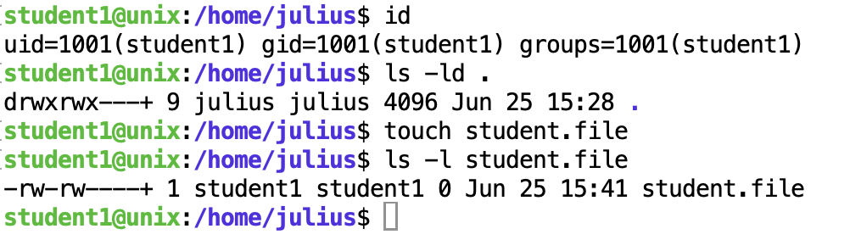
ACL 2
setfacl [option] [action/specification] file
The 'action' would be -m (modify) or -x (remove),
the specification would be the user or group followed by the permissions we want to set.
In this case, we would use the option -d (defaults). So, to set the default ACL for this directory, we would execute:
setfacl -m u:student1:rwx /home/julius
https://www.server-world.info/en/note?os=Ubuntu_22.04&p=acl

Slide 48
ACL 3
- setfacl -b /home/julius
-b Remove all extended ACL entries. The base ACL entries of the owner, group and others are retained.
-R Apply operations to all files and directories recursively.

Slide 49
Questions?

